Slide 1
Welford on Avon
Neighbourhood Development Plan
December 1st, 2013

Slide 2
Agenda
Structure
Neighbourhood Plan
Progress to Date
The Vision for 2028
Key Objectives
New Policy Areas
Save Welford Action Group
Parish Feedback

Slide 3
Structure
Parish Council
Neighbourhood Plan Team
Save Welford Action Group
Strategic Role
Legally Enforceable Result
Late 2014 Implementation
Comprehensive & Diligent
Must be aligned with:
National Policy
District Policy
Tactical Operations Role
Research Applications for Parish Council
Co-ordinate Village Defence
Detailed & Timely Response

Slide 4
Neighbourhood Plan Progress to Date
ONGOING
DONE
DONE
ONGOING
DONE
ONGOING
ONGOING

Slide 5
Neighbourhood Plan Progress to Date
Neighbourhood Plan Area defined and approved
Websites established for parishioners and NP team
Initial survey completed and results collated
Funding & resources secured to minimise costs and add specialist knowledge
Good relationship established with SDC to aid alignment with the Core Strategy
Library/evidence base of relevant documents established
Draft NP Plan document produced for first parish review
First draft policies being drawn up
New policy areas identified for parish feedback

Slide 6
Neighbourhood Plan The Vision of 2028
To have a thriving community village which supports a wide range of village activities including small businesses through good quality community infrastructure such as village meeting places, indoor and outdoor sports facilities and high speed communications.
Housing developments will have been sympathetically integrated into the village environment such that the character of the village and the street scene will have been maintained.
New housing will support home working through high speed communications, to minimise commuting & improve environmental sustainability.
Local infrastructure will have been upgraded to support village growth and the flooding issues will have been resolved.
Traffic issues will have been resolved ensuring the village roads are safe for all residents and public transport connections will have been improved.
Green buffers will have maintained the identity of Welford as distinct from the adjacent villages of Weston on Avon and Long Marston.

Slide 7
Neighbourhood Plan Key Objectives
Accommodate between 51 and 75 new homes within the Parish between 2013 and 2028
All new development should be phased across the Plan period.
Developments which require primary school age children to be educated outside the village would not be supported.
New development should be within the curtilage of the village
New developments should be a broad mixture of affordable and market houses in line with village needs for affordable homes
Developments should be “small scale sites of up to [10-15] houses” and be 'pepper potted' throughout the village

Slide 8
Neighbourhood Plan Key Objectives
Back and/or side garden developments will be assessed on their impact on the distinctive character of the village and alignment with the Village Design Statement.
Developments which place undue strain on village infrastructure are not considered to be sustainable.
The cumulative effects of new housing and commercial developments, within and outside, the village on traffic type and quantity will be a material consideration when considering future planning applications.
Traffic Speed within the Parish is an issue for many residents
Proposals that meet the Governments aspiration to improve rural Broadband reach and speeds will be essential to meet the Vision for a thriving community in 2028.

Slide 9
Neighbourhood Plan Key Objectives
Proposals and Neighbourhood Development Orders which facilitate the development of new Parish facilities would be positively supported and encouraged
The Conservation Area, publically accessible green spaces, local wild life areas and sites of special scientific interest will be protected.
Further development in flood zones will be resisted.
Resist development proposals that link the villages of Welford on Avon and Weston on Avon
Developments should conform wherever possible with the Village Design Statement
Agricultural land surrounding the village will be protected.

Slide 10
Neighbourhood Plan New Policy Area 1 – Dark Skies
Select key parish dark sky locations
Seek designated dark sky site approval from UK Dark Sky Discovery Partnership
Broad prevention of light pollution from business and individual residences (new and existing)

Slide 11
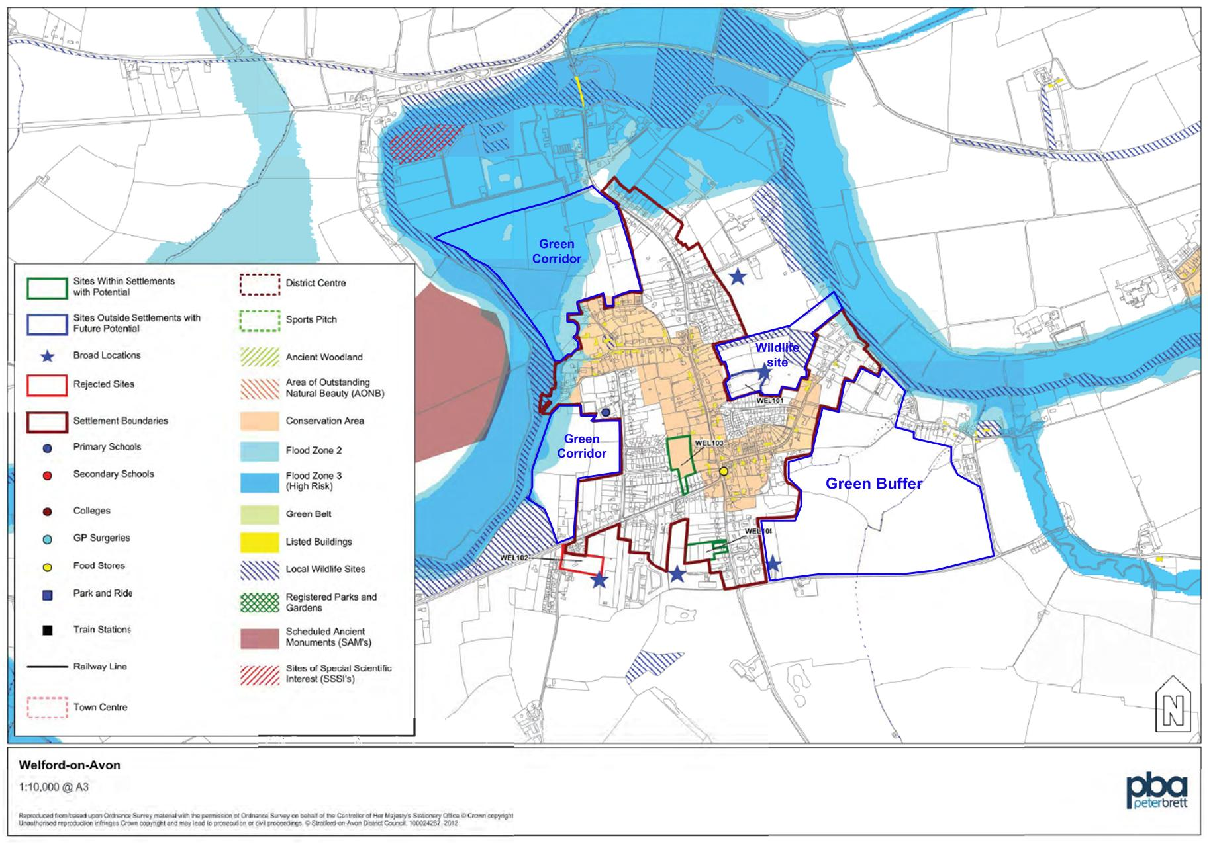
Neighbourhood Plan New Policy Area 2 – Green Buffers
Maintain distinct separation with Weston and Long Marston
Protect key green areas around the built up village

Slide 13
Structure
Parish Council
Neighbourhood Plan Team
Save Welford Action Group
Strategic Role
Legally Enforceable Result
Late 2014 Implementation
Comprehensive & Diligent
Must be aligned with:
National Policy
District Policy
Tactical Operations Role
Research Applications for Parish Council
Co-ordinate Village Defence
Detailed & Timely Response

Slide 14
Save Welford Action Group
Focus only on major planning applications for 10 homes or more
Prepare draft responses for the Parish Council based on sound planning arguments
Keep villagers informed by email, flyers, notice boards and Parish News
Provide ‘bullet points’ for villagers to respond to SDC
Organise residents’ participation at SDC planning committee meetings

Slide 15
Save Welford Action Group Proposed Developments as at 1st Dec 2013
Site | Applicant | Submitted | Number houses | Parish Council | SDC planning committee | Case Officer
Ashgrove | Cala | 5 Aug 13 | 20 | Object | 4 Dec 13 | GRANT
Fairlea | Banner | 20 Aug 13 | 18 | Support | 4 Dec 13 | GRANT
Milcote Road | Gladman | 12 Sep 13 | 95 | Object
S Barton Rd | McKay | 23 Sep 13 | 8+4 | Support
The Willows | Spitfire | 27 Sep 13 | 15 | Object
Millers Close | TBA |  | 20 - 30
Total |  |  | 180-190
Current Welford housing objective up to 2028: 51-75 dwellings

Slide 16
Parish Feedback We need your views on.....
Draft Vision
Draft Objectives
New Policy Areas
Please complete the feedback form provided when you arrive and give it to a member of the team.
Please give us your email address so all of the parish council groups dealing with planning can keep you informed.
Please take away your copy of the draft Plan if you wish to review it further and provide additional feedback.

